Slide 1
University Retention Rate on an Institutional Level
By Daniel Immediato
NYC DSA – Python Project
February 27th, 2023
Notes:
For my project, I decided to do university retention rates because I used to work in an office of academic assessment.

Slide 2
Why Do We Care?
What is Retention Rate?
Retention’s most basic definition is: “the proportion of students from one year's fall term that re-enrolled during the following year's fall term.”
The average retention rate for the 2021-22 cohort was about 70%
https://collegescorecard.ed.gov/data/
Notes:
For a bit of background, in these offices, universities look at First Year experience and use that as a measure to gauge how well it’s doing as a whole. One of the biggest measures for first year experience, besides the self-reported surveys, is the retention rate. Defined, retention is whether or not a student returns the following year. In an ideal world, retention is supposed to increase nationally every year, but it suffered because of the coronavirus epidemic. The average retention rate for the 2021-22 cohort was about 70%.

Slide 3
Quality
Funding
Why Do We Care?
Does it Matter?
Retention dictates quality
-higher retention means more prestige
Colleges are encouraged to increase retention to receive federal funding
Completion
Retention is directly correlated with completion rate
Notes:
Why does retention matter? Students often look at retention rates of colleges when determining their reputation. In other words, a good college is one with a high retention rate. Also, community colleges are pressured to reverse low retention trends to receive federal funding. Finally, retention is directly correlated with completion rates. A college with high retention means more students completing it, and therefore more income.

Slide 4
What Factors Influence Retention?
Texas Case Study
College Scorecard
Research Question
The Texas University System in 2016 collected information from over 6,000 First Year students.
This includes retention rate, GPA, High School GPA, the type of college attended, and whether they were instate or out of state.
The college scorecard is an institution-level data file updated annually by the Department of Education. It contains over 6,000 rows and 3,000 columns.
The data refers to various aspects of a university’s “transparency”. This includes completion rates, retention rates, average income of families, the demographics of the institutions, future success of the students, and so on.
Notes:
But what factors influence retention? To help discover this, I used two datasets. One was a case study of a specific school system. Another was the Department of Education’s College Scorecard. College Scorecard is a national analysis of over 6,000 universities and measures “transparency”, but both actually had an equal number of rows.

Slide 5
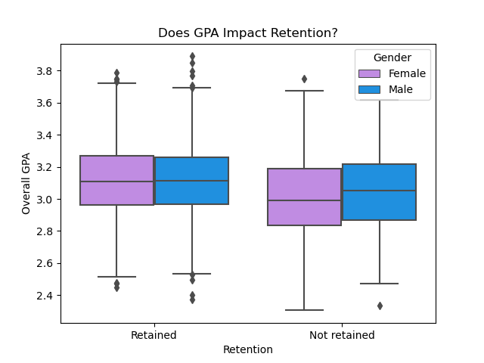
Texas Case Study
The Given Factor: Overall GPA
Overall GPA and Retention
Educational success (probably) influences retention in some way
The Texas case study allows us to see if GPA is an influencer, how much it acts as an influencer, and if we can apply that to other institutions.
We can see here that overall GPA does impact retention rates.
Retained Mean: 3.113918 Not Retained Mean: 3.023611
P< 2.2e-16
Notes:
To begin, one thing most blatantly stated factors is that students doing well tend to stay in college. This box plot shows that there is a statistically significant difference between those retained and those not retained for the school year, with those retained having a higher GPA. However, the actual mean difference didn’t vary by much. It also showed an inverse trend for gender.

Slide 6
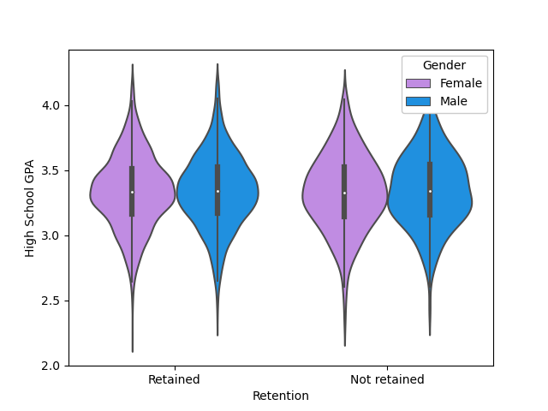
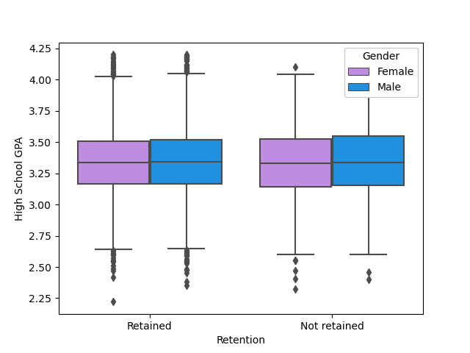
What About HS GPA?
Texas Case Study
High School GPA shows the problems of outliers more prominently. There are so many outliers (more clearly noted in the violin plot to demonstrate density), that it caused the plot to be inflated around the center for the retained, being pulled by one extreme and the other.
Retained Mean: 3.338728 Not Retained Mean: 3.340696
P=0.8433
Notes:
However, I do want to bring the GPA into question. The violin plot here analyzes HS GPA, which has notable outliers. For every one extreme, it was balanced by the other extreme, causing the graph to become bloated around the median with a statistical significance ironically extremely close to 1.

Slide 7
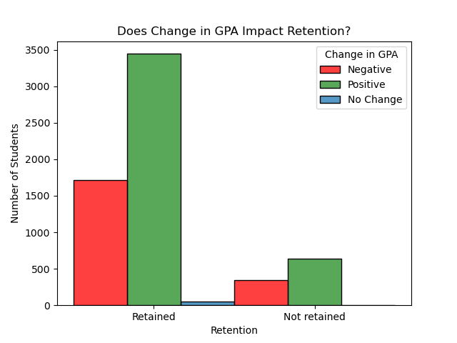
Texas Case Study
Is There Hope?: Student Success
Direction of GPA Change Throughout First Year
Change in GPA is whether, over the year, the student’s GPA changed in a positive or negative direction. Or didn’t change at all.
While most of the students had some sort of a change, there wasn’t a significant difference when it comes to changes in GPA.
This is likely due to “strength” of the changes not being taken into account
Χ²=2.969
P=0.2266
Notes:
Further bringing into question GPA, it would appear that the direction of change in GPA seems to be more due to chance. While not as extreme as HS GPA, GPA change was also not statistically significant in retention. However, it should be noted that it doesn’t take into account the “strength” of the actual change.

Slide 8
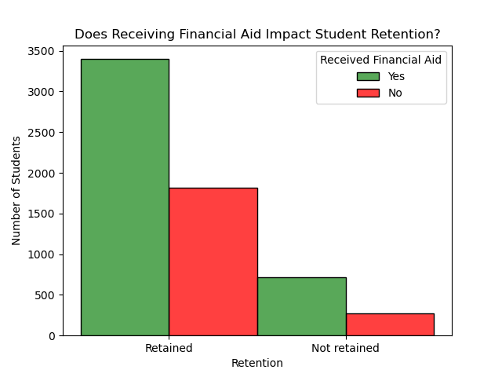
Texas Case Study
Are Students Being Buried?: Debt
Students often cite financial burdens as one of the main reasons as being unable to attend college. This was compounded during the coronavirus epidemic, which saw a national-level decrease in university retention rates.
While the TUS case study does not provide actual university costs per study, nor cumulative debt, it does provide whether or not the student received any sort of financial aid.
While the graph appears similar to GPA trends, the differences between means were enough to be statistically significant.
If the Student Received Financial Aid for First Year
Χ²=17.193
P=3.376e-05
Notes:
Therefore, we have to look at the largest blame for poor retention: financial burden. The closest information we could gather is that there is a significant difference in expected frequencies between those retained and not retained in regards to whether or not someone received financial aid. However, this only covers if they received a loan to begin with, which doesn’t tell us much.

Slide 9
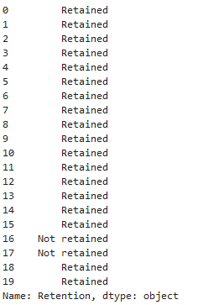
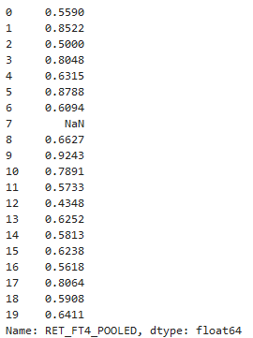
Differences of Retention
If GPA and debt influences retention, can that be applied on an institutional level?
TUS Retention
College Scorecard
TUS and College Scorecard measure retention differently.
TUS was a categorical object
College Scorecard was technically a “string with NaN values” and had to be converted to a float
NaN values often had to be dropped, including if value was “Privacy Suppressed” (discussed in Future Works)
Notes:
So what about on a national level? First some side notes, TUS was a categorical variable and College Scorecard had to be converted to a float. Scorecard also had multiple NaN values. So the data can’t be compared directly 1:1. TUS is also much older.

Slide 10
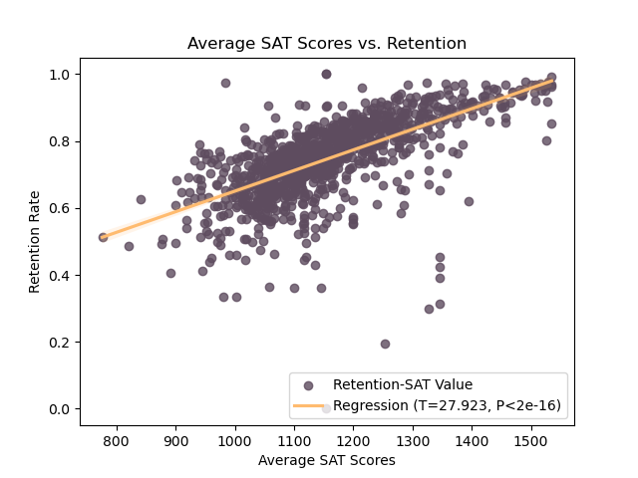
A Comparison: SAT Scores
Positive Regression
College Scorecard did not provide average GPA, so the closest thing it provided to academic achievement was SAT scores, which would therefore be an estimate of entrance GPA. And we already know that “change in GPA” might not matter.
This is the most clear example of a linear positive regression we have. But, like with HS GPA, this should be taken with caution for two reasons: most colleges do not report SAT scores and a high SAT score usually means acceptance into a university that demands as such. That means the university is already successful at retaining students.
SAT Scores as Provided by the University (See Future Works)
Notes:
Academically, the closest thing CSC has to GPA is SAT scores. Many colleges take SAT scores into consideration in regards to admission. Here, it would seem that there is probably a positive relationship between the two. Like with GPA, this was statistically significant, although it would contradict the HS GPA result. The t-value measures the size of the difference relative to the variation in your sample data.

Slide 11
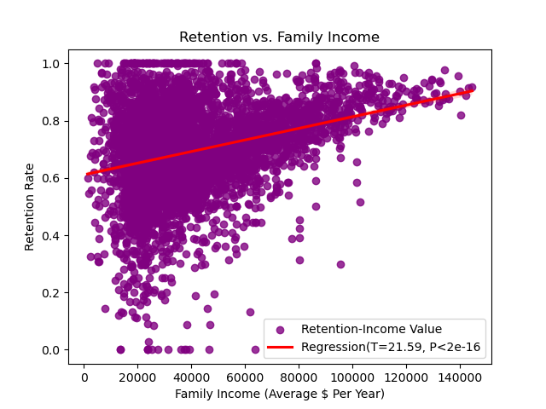
Positive Regression
Easier for Some?: Family Income
If one of the universal predicting factors in attending college is whether or not someone can afford it, then surely income would be positively correlated with retention.
The cluster really just shows the average national income, but this does demonstrate that once moving away from the mean students are more likely to stay into their sophomore year.
However, it should be noted that even those who have the mean family income still have a tendency to both have the greatest retention rates and also the worst.
Average Family Income Per Year
Notes:
Before testing for financial burdens, I tested for income and the results aren’t surprising. There’s the cluster for the average income around 45k, and then we have those who make more having a higher retention universally. This was attempted for “individual income”, but most students have the same income, which resulting in just a blob.

Slide 12
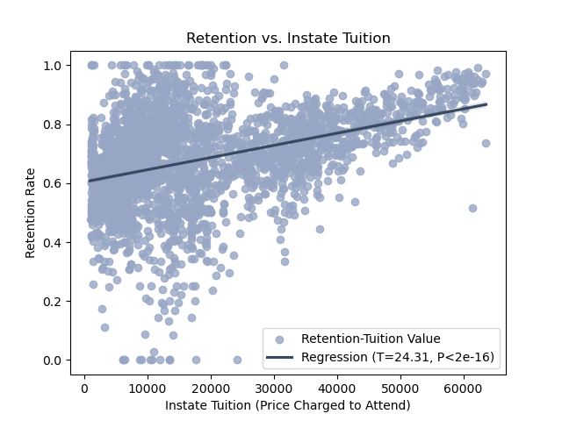
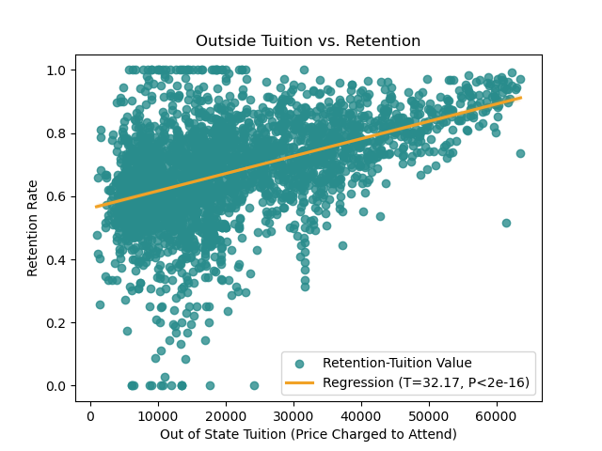
Positive Regression
Not Always Expected: Tuition Cost
One of the most significant factors on “why” one might attend a university would be tuition, but what about with retention? Unexpectedly, it would seem that the more costly a university is, the more likely students are to come back to it. This is probably due to: investment, where students feel obligated to complete a year they spent a large amount of money in, and faculty/reputation, universities that cost more usually have better facilities to deal with factors that affect student retention.
Notes:
Ironically, for both out of state and in state tuition, as tuition cost increases, retention rate also increases. I mainly blame this on investment: if you already paid for it, you want to get what you pay for. I also blame facilities: more costly universities already know how to deal with retention issues.

Slide 13
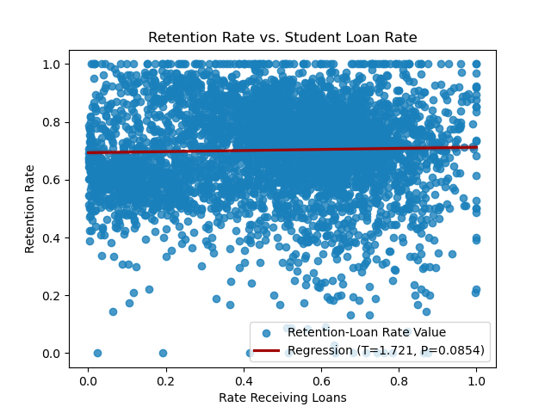
Negative Regression
What Was That About Debt Again?
College Scorecard has a somewhat similar variable as the TUS did for debt, except it’s measured as a percentage/ratio. Here it’s defined as “percent of undergraduates receiving federal loans”.
This graph is hard to read and all over the place, but is included so one can see that there is no statistical significance.
Percent of Undergraduates Receiving Federal Loans
Notes:
With income and tuition out of the way, this brings us back to debt. CSC had this as a ratio, and the results were much different. Instead of being glaringly statistically significant, the standard error here is high and the strength of the relationship is almost a horizontal line.

Slide 14
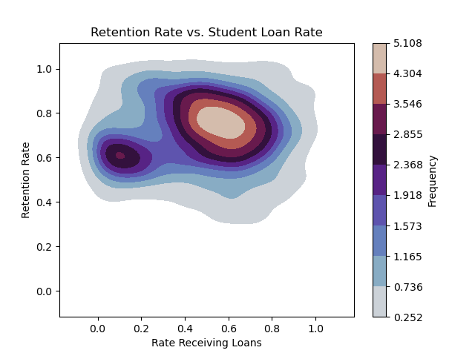
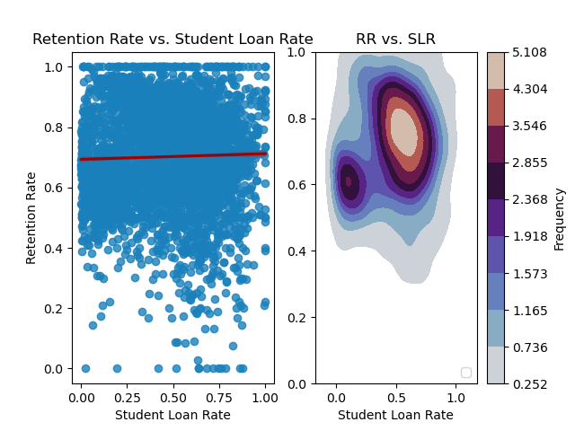
Negative Regression
A heat map can be used when there’s large clusters, and we want to see the frequency of where the clusters are. The bar on the right shows the frequency/elevation level.
We can see more clearly that, while most students are receiving loans, it’s offset by a cluster not receiving loans and still having similar retention.
Percent of Undergraduates Receiving Federal Loans
Notes:
As a heat map, we can more clearly see that the main cluster is offset by the rate not receiving loans with those who are, with the results ultimately just not mattering since they’re so close to each other.

Slide 15
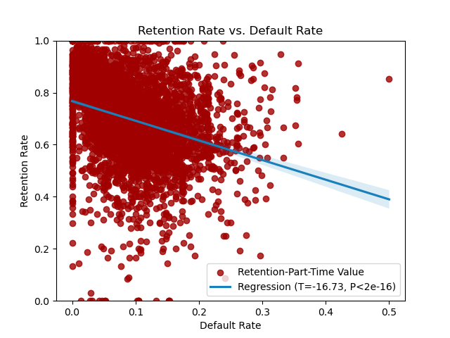
Negative Regression
Can We Measure Loans Differently?: Default
The default rate is a measure of the sense of debt burden of attending college and loan performance. It also measures a borrowers' behavior after they leave the university.
Interestingly, for universities with a higher default rate, they also had a lower retention rate, even though these students would currently be experiencing a deference.
Students experiencing severe financial burden may default, and if they don’t have the right resources to deal with this then it show cases a college’s inability to encourage success (See Future Works and the correlation between Retention Rate and Completion Rate).
Two-Year Cohort Default Rate
Notes:
Since that graph didn’t help us, can we measure loans a different way? Well, CSC had default rate. While that doesn’t affect retention directly, it does measure “outcome” and retention is directly correlated with completion rate. So here, we see that, this time, it is significant.

Slide 16
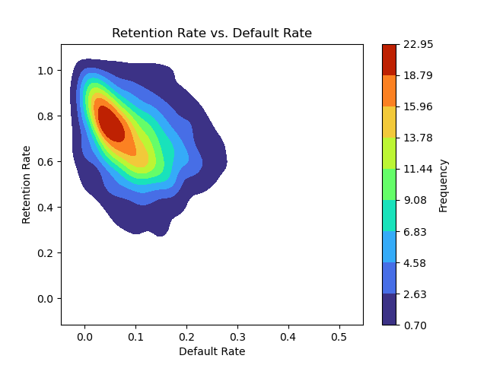
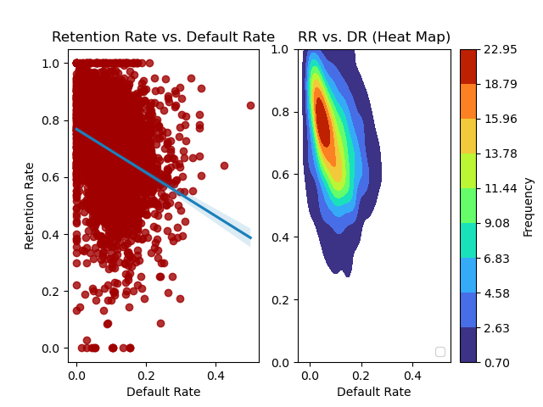
Negative Regression
A heat map more clearly shows the negative correlation, where the cluster begins in the “upper left” with a high value and then moves towards the bottom right. This shows that, if they have a low default rate, retention rates are high, but as soon as they do, retention rates start lowering.
Two-Year Cohort Default Rate
Notes:
If students aren’t handling their loans after the university, then the colleges aren’t equipping them well enough, leading to lower retention rates. The cluster is much more visible here. Universities with minimal default rates seem predisposed to have higher retention rates, and then as soon as the default rate increases, retention rates start dropping.

Slide 17
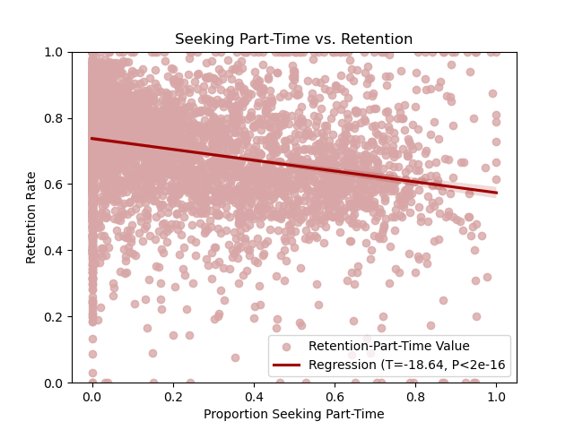
Negative Correlation
Does Part-Time Equal Commitment?
Retention rate had a separate variable for part time students. However, there was a variable for the proportion of students that were seeking part-time at the university.
It’s no surprise that those individuals who invest more time in the university are more likely to return. These are the students are better able to take advantage of its facilities, attend its clubs, interact with its professors, and may also be the focus of university outreach programs.
Proportion Seeking Part-Time
Notes:
Do part-time students put in less effort? It was consistently shown, as the proportion of part time increased, then retention decreased. One must consider that schools are probably more interested in focusing on keeping full-time students, plus part-time students might be more likely to transfer.

Slide 18
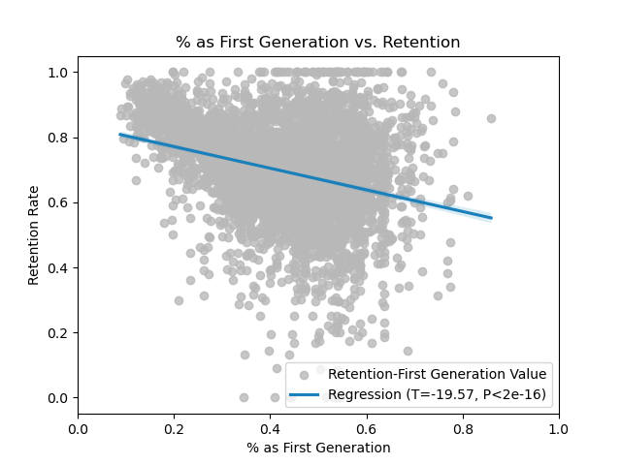
Negative Regression
That Extra Push: The First Generation
In the student’s FAFSA, if at least one parent’s status was “college” then it was coded as non-first generation.
First generation students are often seen as “risk” because of their uncertainty in navigating the college landscape. They have less aid from their parents, and, if previous graphs are to go by, they might have less family income which means less retention.
This graph also shows what is to be expected. First generation students tend to have lower retention rates than their counterparts.
% of Students Who Had No Parents In College
Notes:
First generation students, as quoted personally feel “lost” if they have no one to guide them. This especially occurs with transfer students. That’s why first generation students are often seen as “risk students”.

Slide 19
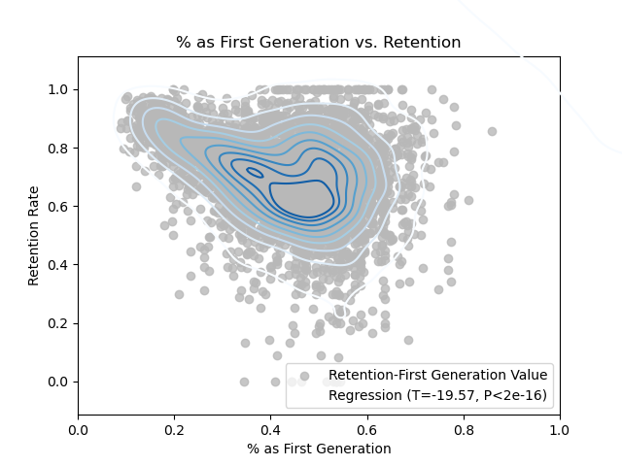
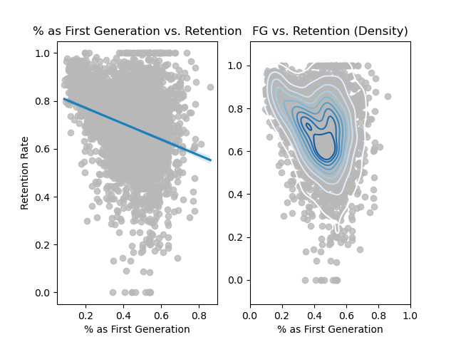
Positive Regression
When we break down the first generation into density, we can more easily see two things: most colleges have above 40% of their student body as first generation. However, when this rate decreases, retention increases almost unilaterally.
% of Students Who Had No Parents In College
Notes:
Based on the 2D density plot, it’s much more apparent how universities with nearly no students that are first generation have a higher retention rate, but once they start reaching 50% it levels out somewhat, with a still decreasing trend.

Slide 20
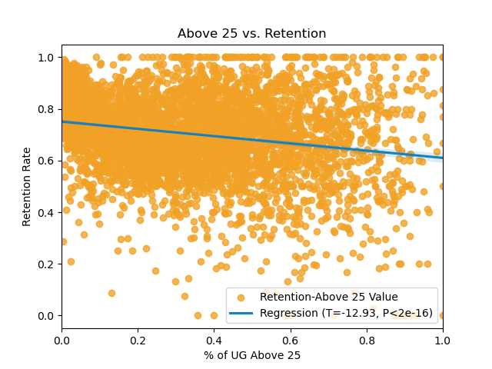
Negative Regression
The Accumulation of Factors: Age
Most people entering universities tend to be in their young adulthood. College Scorecard divides them into two groups, those 24 and below, and those above the age of 25.
25 and above was taken because it represents the accumulation of the independent variables taken: possible previous school debt, higher income, more financial burdens, and more distractions in general.
This graph shows that, while not glaringly obvious, there is general negative correlation. However, it should be taken with a grain of salt because “above 25” could mean anything 25 and above for any university. IE, some universities might just happen to have a lot of 26 year-olds, which is too similar to 24 to mean anything.
Undergraduates Above 25
Notes:
What does age mean? It means more responsibilities, both less and more income, and more financial burdens. This does show a negative trend, but it should be taken with a grain of salt because the Department of Education defined it as anyone “above 25”.

Slide 21
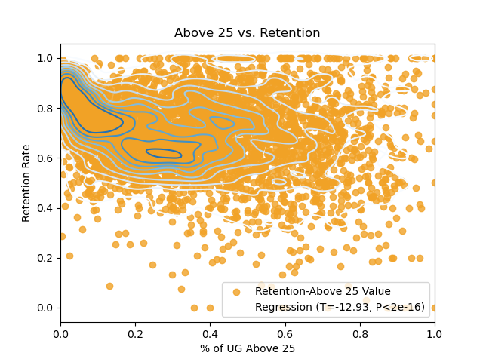
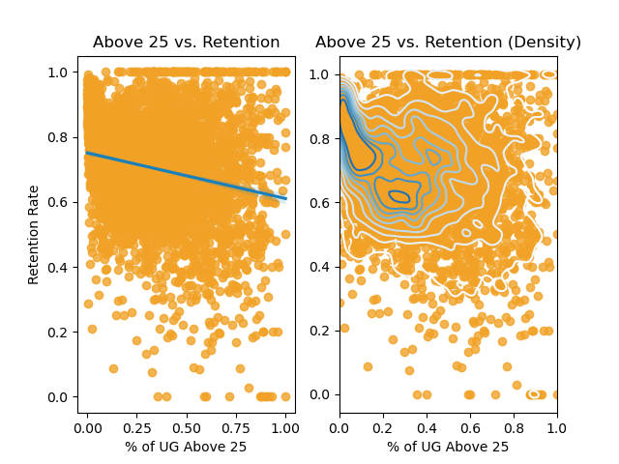
Negative Regression
The density plot more clearly shows A) that most undergraduates are under 25 and B) when the institution has most undergraduates under 25, the retention tends to be higher.
Undergraduates Above 25
Notes:
If it wasn’t as clear in the previous graph, we can more clearly see in the density that most institutions have a cluster around the less than 20%, with the higher retention, and as soon as it starts trailing off there is a negative trend. However, then the spread tends to go all over the place.

Slide 22
Conclusion and Future Work
Conclusion: Does this Mean Anything?
What We Know
Things to Consider
GPA influences retention, but may be offset by large variances.
Initial debt is not a negatively contributing factor, but a student’s ability to handle it is (this includes family wealth).
Those seeking part-time are less likely than those seeking full-time to maintain retention.
A first generation student is less likely to be retained than a non-first generation student.
Students who are more likely to have other burdens (those who are older) are more likely to not be retained.
The Texas case study was only one school system out of many, and therefore doesn’t represent them all.
There were many NaN’s in the College Scorecard record. This includes “Privacy Suppressed” values, which is where the data was excluded.
Retention was a ratio throughout, which doesn’t always correlate well when the other variables are non-ratios that don’t mean the same thing.
“Retention” does not factor in transferring, and neither do many institutions. Often choosing to not even report it. Certain results, like SAT scores and “median debt”, were also “estimated by the university”, which can be unreliable.
Notes:
Conclusions. GPA and SAT scores might mean something, but could be offset by various other factors. Loan variation is all over the place and amount should be looked at instead. Wealth is a positive contributing factor. Default rate is a telling factor of retention. And older, part-time, first generation students would be at risk. However, we should also consider that most of these universities provided their own results and often didn’t take transfer students into account.

Slide 23
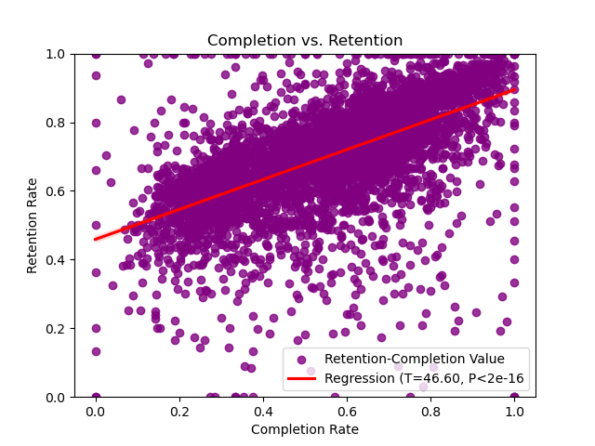
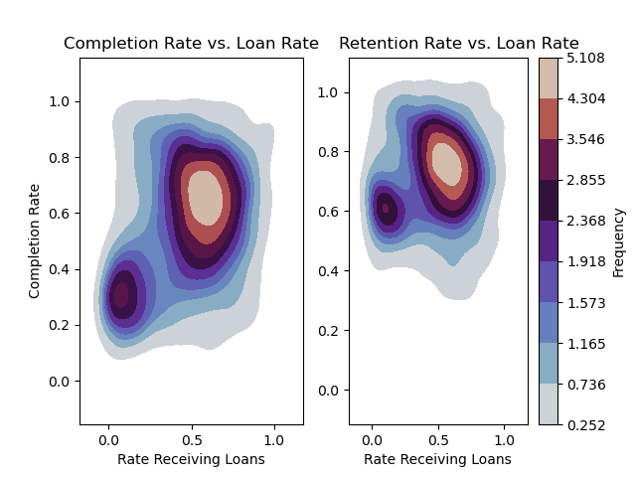
Conclusion and Future Work
Future Work:
Completion
Completion is defined as whether or not a student has achieved academic goals, within a certain defined percentage of expected time (usually 150%).
It is directly correlated with retention rate. The higher retention of an institution, the higher the completion rate.
In fact, it is so correlated that many of the same graphs look extremely similar.
It’d be interesting to see if this applied to all factors.
Notes:
Retention rate can be replaced with “completion rate”. The two are directly correlated and almost interchangeable. As one increases, the other increases. It’d be interesting to see completion used instead, as well as having it divided between those who received loans or not.

Slide 24
Demographics
Machine Learning
Conclusion and Future Work
L4 vs. 4 Year
Degree Type/Public or Private
Other Future Work
How much do the various demographics of a university influence retention rate?
This includes the correlation between staff and student body that share the same demographics.
Can we use machine learning to understand future student behavior in regards to retention?
Can said machine learning identify “at-risk”, “high-risk”, and “traditional” students?
Does the type of degree one is pursuing impact retention rate? What about whether the university is a public or a private one?
Do schools that only have a less-than-4 year program have lower or higher retention rates than those with full four year programs?
Notes:
Other possible suggestions include splitting the demographics, including by faculty and their student body. Dividing the retention between full time and part time retention. Splitting the schools between L4 and 4 year. And grouping by degree type and/or university type. Whether machine learning can be used to identify student behavior in regards to retention. And finally, using a time-series.

